Slide 1
Research

Slide 2
“Machine Learning”: Benefits
-> Bigger data: More variables (and observations)
-> More flexible models
(Deep) neural networks
Random forests
Support vector machines
....
-> Increased focus on prediction of new cases / generalizability

Slide 3
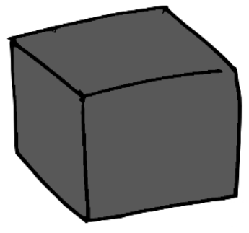
“Machine Learning”: Challenges
-> Interpretability
-> Uncertainty quantification & inference
-> Often traditional methods perform as well as ML and AI
e.g., Christodoulou et al. (2019); Youyou et al. (2015); Gravesteijnet al. (2020); Yildiz et al. (2017); Piroset al. (2019); Fokkema et al. (2022)

Slide 4
My research
Aim: Flexible modeling, near-optimal accuracy, human interpretable
- Identify a few relevant predictors (from very many)
Non-linearities represented as simple decision rules
Allow for uncertainty quantification and inference

Slide 5

GLMM trees
Aim: Find subgroups with
-> differential effects of treatment
-> different trajectories over time
-> ...
Can deal with large numbers of possible predictors
Implemented in R package glmertree
350 weekly downloads
Fokkema et al. (2018) Behavior Research Methods
Fokkema et al. (2021) Psychotherapy Research

Slide 6
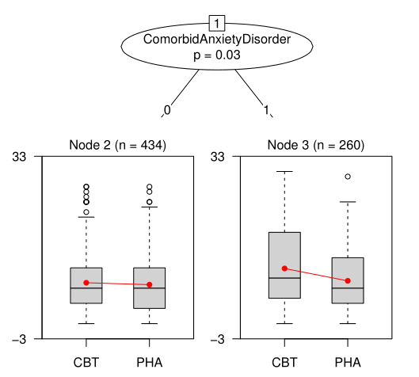
GLMM trees
IPDMA on effects of treatment for depression:
Cognitive Behavioral Therapy (CBT)
Pharmacotherapy (PHA)
694 observations from 7 studies
Outcome: post-treatment HDRS
Possible predictors (moderators):
Age
Gender
Level of education
Pretreatment HDRS
Comorbid anxiety disorder
…

Slide 7
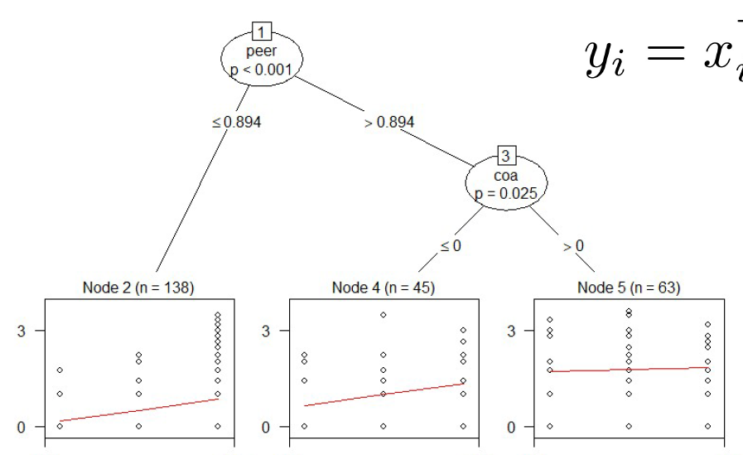
GLMM trees
Alcohol use trajectories: 82 adolescents at age 14, 15, or 16
Possible predictors:
Coa: alcoholic parent (1) or not (0)
Male (1) or female (0)
Peer alcohol use at age 14

Slide 8
Prediction Rule Ensembles
Aim: Extract simple set of rules from black-box random forests while retaining accuracy
Implemented in R package pre
350 weekly downloads
Fokkema (2020) Journal of Statistical Software
Fokkema & Strobl (2020) Psychological Methods

Slide 9
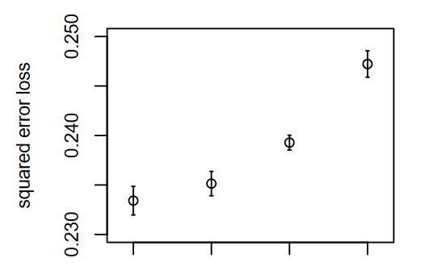
Prediction Rule Ensembles
682 patients with depression, which have chronic trajectory?
20 possible predictors
Rule | Coefficient
(Intercept) | -0.218
IDS > 10 & LCImax > 0.263 | 0.246
IDS > 13 & LCImax > 0.362 | 0.152
IDS > 10 & LCImax > 0.328 | 0.140
IDS ≤ 16 & Age_onset > 17 | -0.083
LCImax > 0.260 & IDS > 9 | 0.016
IDS ≤ 16 & G_Anx_D = FALSE | -0.005
Random Forest | PRE | Lasso regression | Tree

Slide 10
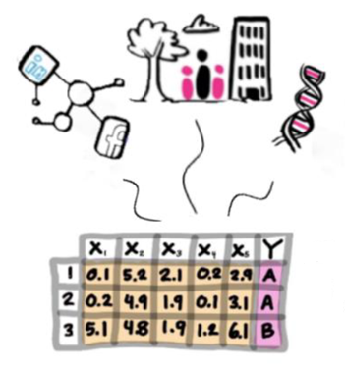
Multi-view Data
Implemented in R package Multiview (1st official release this summer)
Van Loon et al. (2020) Information Fusion
Van Loon et al. (2022) Frontiers in Neuroscience

Slide 11
Next 3 years
Causality
Uncertainty quantification through Bayesian methods
Meta-analysis of variable importances
Detecting shape differences in trajectories

Slide 12
Prediction Rule Ensembles
Causal inference in observational data, e.g.:
Which children are most (least) adversely impacted by parent’s financial trouble?
Which patients benefit most (least) from a given treatment program?
(Bayesian) uncertainty quantification
Infere
nce: Impossible for most ML techniques
Meta-analysis: Influence of predictors from machine learning models
-> VIDI application 2023
-> NWO Open Competition (XS and M)

Slide 13
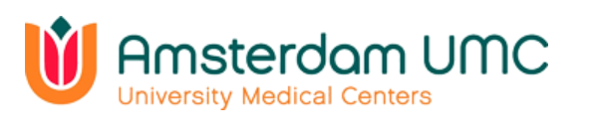



Prediction Rule Ensembles
Causal inference in observational data, e.g.:
Which children are most (least) adversely impacted by parent’s financial trouble?
Which patients benefit most (least) from a given treatment program?
(Bayesian) uncertainty quantification
Inference: Impossible for most
ML techniques
Meta-analysis: Influence of predictors from machine learning models
-> VIDI application 2023
-> NWO Open Competition (XS and M)

Slide 14


Prediction Rule Ensembles
Causal inference in observational data, e.g.:
Which children are most (least) adversely impacted by parent’s financial trouble?
Which patients benefit most (least) from a given treatment program?
(Bayesian) uncertainty quantification
Inference: Impossible for most ML techniques
Meta-analysis: Influence of predictors from machine learning models
-> VIDI application 2023
-> NWO Open Competition (XS and M)

Slide 15
Prediction Rule Ensembles
Causal inference in observational data, e.g.:
Which children are most (least) adversely impacted by parent’s financial trouble?
Which patients benefit most (least) from a given treatment program?
(Bayesian) uncertainty quantification
Inference: Impossible for most ML techniques
Meta-analysis: Influence of predictors from machine learning models
-> VIDI application 2023
-> NWO Open Competition (XS and M)

Slide 17
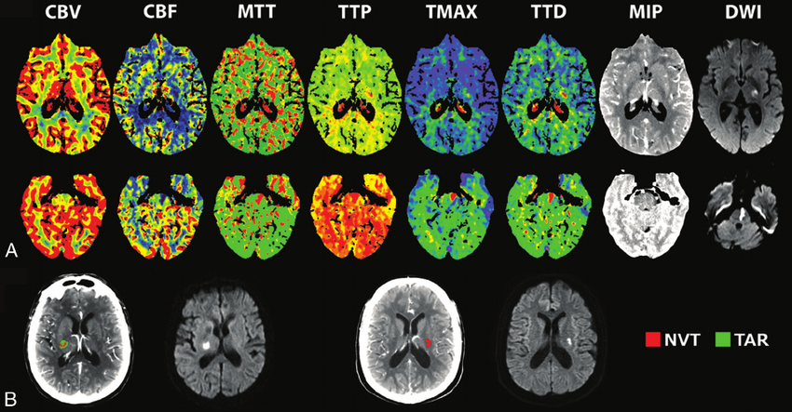




Slide 18
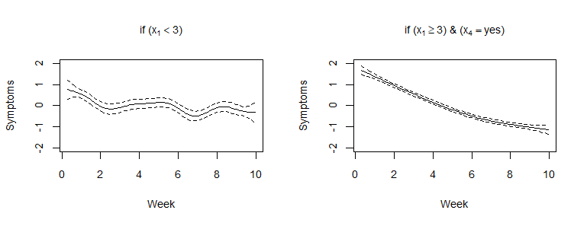
# life events in past year
# life events in past year
< 3
≥ 3
< 3
≥ 3
single
symptoms
“no”
“yes”
week
symptoms
week

Slide 19

Multi-view Data
Sept 2023: New PhD student within GUTS Zwaartekracht program

Slide 20
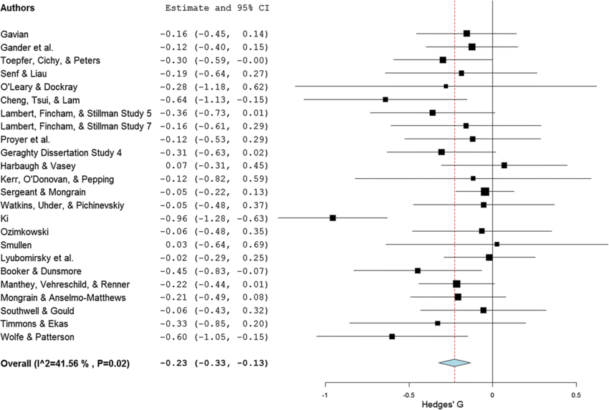
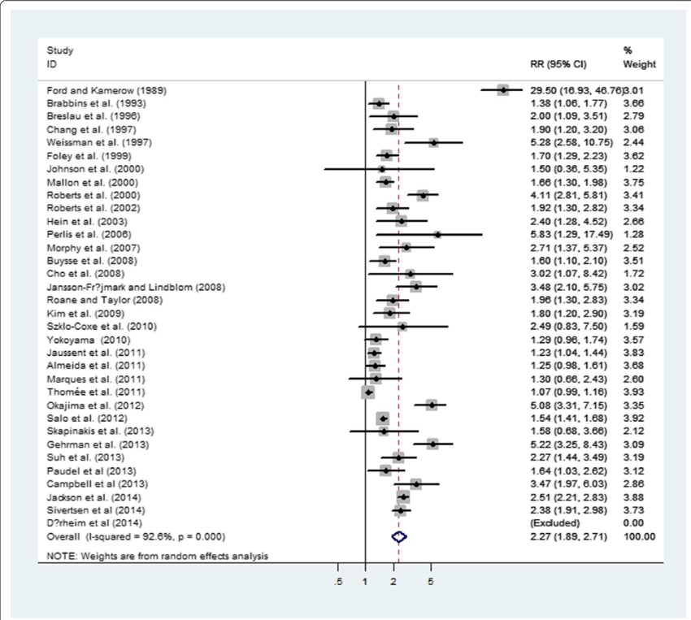

Slide 21




Slide 22



Slide 23
References
Fokkema, M., Smits, N., Zeileis, A., Hothorn, T. & Kelderman, H. (2018). Detecting treatment-subgroup interactions in clustered data with generalized linear mixed-effects model trees. Behavior Research Methods, 50(5), 2016-2034. http://doi.org/10.3758/s13428-017-0971-x
Fokkema, M. (2020). Fitting prediction rule ensembles with R package pre. Journal of Statistical Software, 92(12), 1-30. http://doi.org/10.18637/jss.v092.i12
Fokkema, M. & Strobl, C. (2020). Fitting prediction rule ensembles to psychological research data: An introduction and tutorial. Psychological Methods 25(5), 636–652. http://doi.org/10.1037/met0000256 https://arxiv.org/abs/1907.05302
Fokkema, M., Edbrooke-Childs, J. & Wolpert, M. (2021). Generalized linear mixed-model (GLMM) trees: A flexible decision-tree method for multilevel and longitudinal data. Psychotherapy Research, 31(3), 313-325. https://doi.org/10.1080/10503307.2020.1785037
Fokkema, M., Iliescu, D., Greiff, S., & Ziegler, M. (2022). Machine learning and prediction in psychological assessment: Some promises and pittfalls. European Journal of Psychological Assessment 38(3), 165-175. https://doi.org/10.1027/1015-5759/a000714
van Loon, W., Fokkema, M., Szabo, B., de Rooij, M. (2020). Stacked penalized logistic regression for selecting views in multi-view learning. Information Fusion, 61, 113-123. https://doi.org/10.1016/j.inffus.2020.03.007
van Loon, W., de Vos, F., Fokkema, M., Szabo, B., Koini, M., Schmidt, R., & de Rooij, M. (2022). Analyzing hierarchical multi-view MRI data with StaPLR: An application to Alzheimer's disease classification. Frontiers in Neuroscience 16, 830630. https://doi.org/10.3389/fnins.2022.830630

